Slide 1



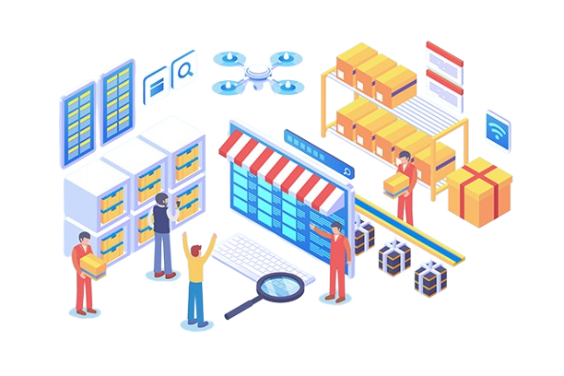
Sustainable Supply Chain Performance Dashboard

Slide 2
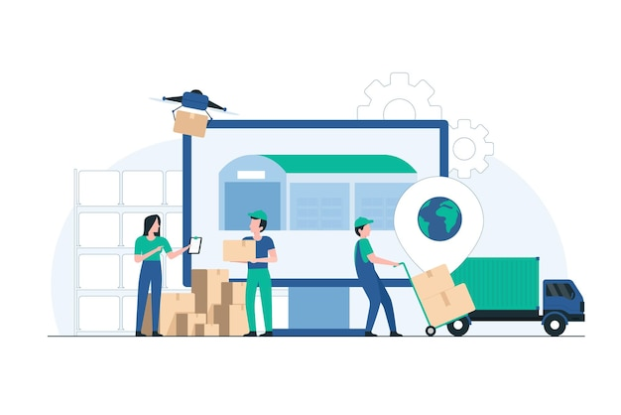

Learning Objectives
Goals
To develop a comprehensive, data-driven dashboard that enables businesses to optimize their supply chain processes while minimizing environmental and financial impacts.
Learning Objectives:
Understand the role of sustainability in supply chain management.
Analyze key performance metrics like lead time, defect rates, and stock levels.
Utilize data visualization techniques for efficient decision-making.
Leverage Power BI to track and optimize supply chain performance.
Source :
www.freepik.com/

Slide 3



Tools and Technology
Power BI Data visualization and dashboard creation
Excel Data storage and preprocessing
Power Query Data transformation

Slide 4


Methodology & Problem Statement
Methodology
Data Collection: Gather data and Make the needed tables.
Data Cleaning & Transformation: Use Power Query to preprocess and structure the data for analysis.
Dashboard Design: Create interactive visualizations for supply chain tracking, ensuring clarity and usability.
Trend Analysis: Identify patterns in supply chain operations, such as delays, inventory levels, and supplier performance.
Optimization & Insights: Analyze the impact of various supply chain processes on cost, efficiency, and sustainability, helping in decision-making.
Problem Statement
Traditional supply chain operations often lack real-time insights, leading to inefficiencies in inventory management, logistics, and supplier performance. Businesses struggle to balance cost, efficiency, and sustainability.
Solution
The Sustainable Supply Chain Performance Dashboard provides real-time analytics on inventory, supplier efficiency, transportation modes, and defect rates. It helps decision-makers streamline operations while ensuring sustainability and cost-effectiveness.

Slide 5
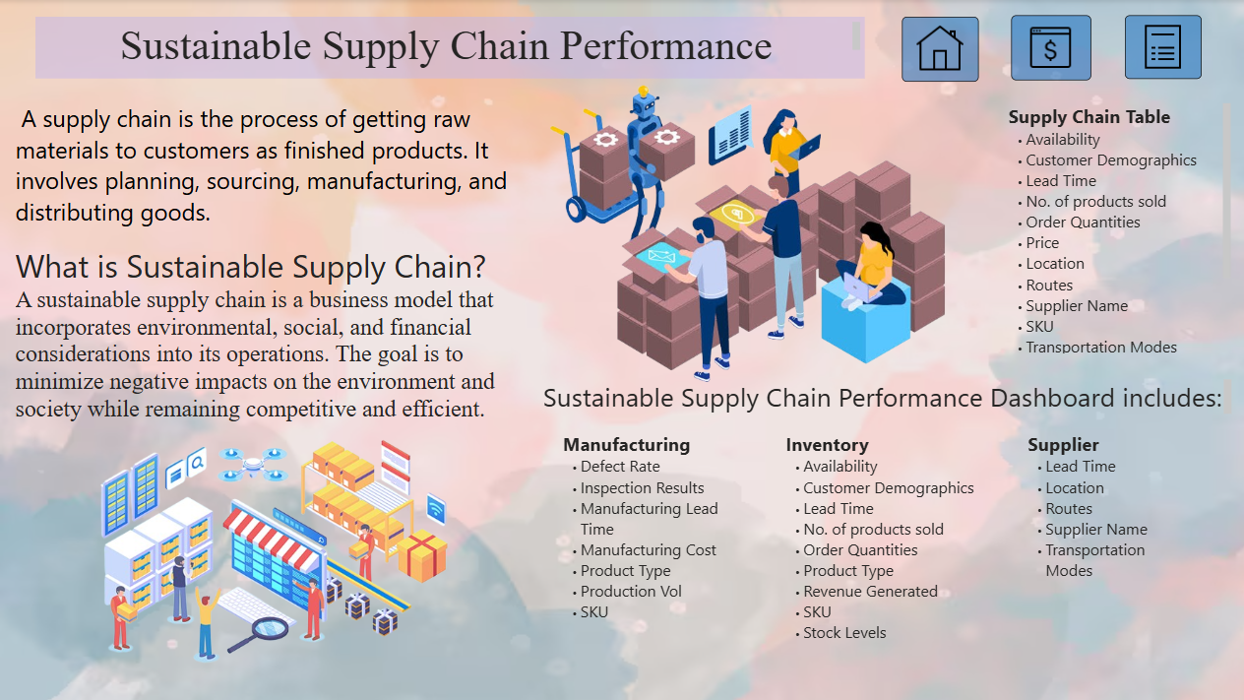
Dashboard (Home)

Slide 6
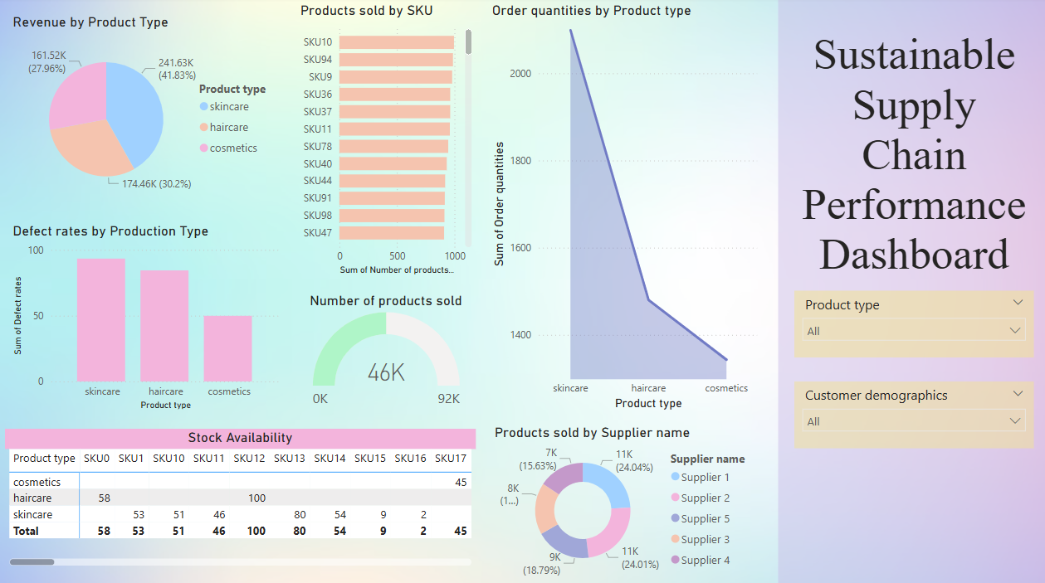
Dashboard (Sales & Product Performance)

Slide 7
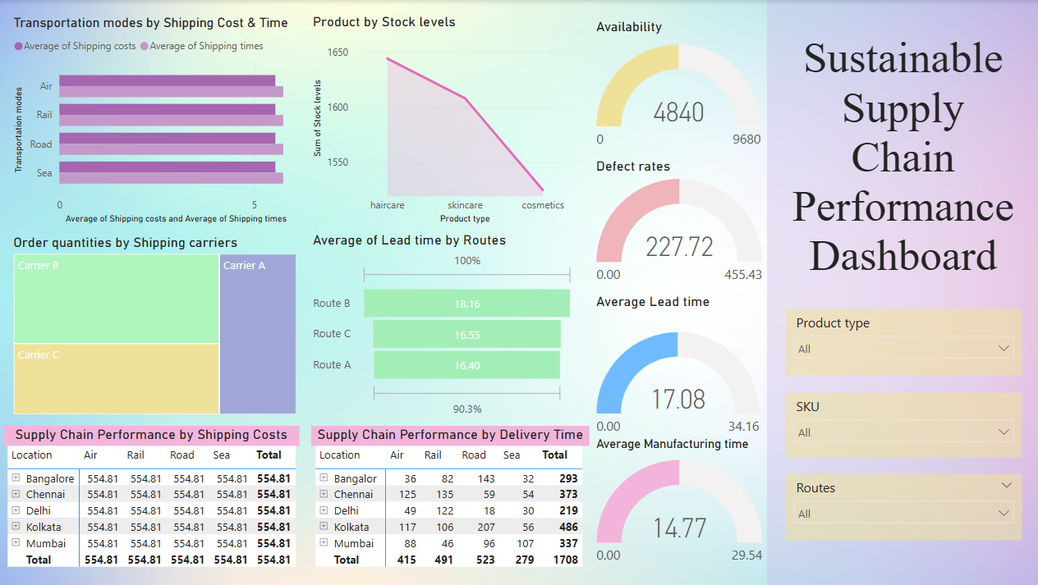
Dashboard (Inventory, Manufacturing & Supply)

Slide 8
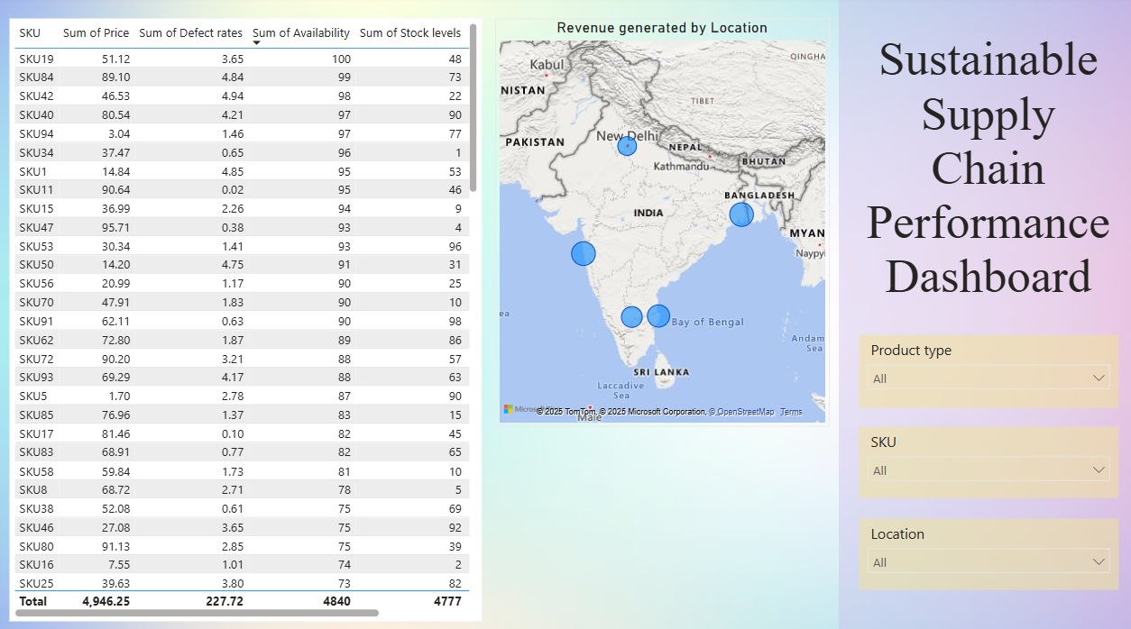
Dashboard (Summarize)

Slide 9
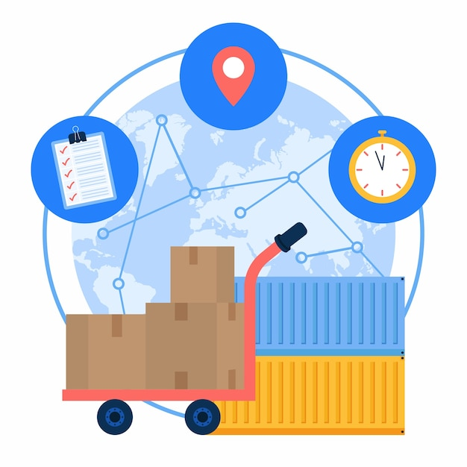
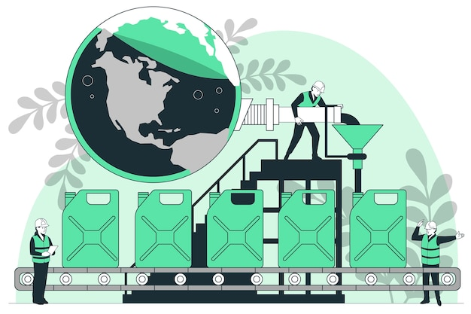
Conclusion
The sustainable supply chain dashboard provides a comprehensive visualization of various supply chain operations, enabling businesses to make informed decisions. By integrating real-time data from suppliers, logistics, and inventory systems, the dashboard enhances transparency and operational efficiency. Through interactive visualizations, businesses can identify inefficiencies, track supply chain trends, and evaluate the impact of different processes on cost and sustainability. The insights derived from the dashboard support proactive decision-making, helping organizations optimize resources, reduce waste, and improve overall supply chain resilience. This approach not only ensures smoother supply chain operations but also aligns with sustainability goals, fostering long-term profitability and environmental responsibility. The dashboard serves as a valuable tool for businesses aiming to balance efficiency with sustainable practices in a dynamic market environment.
By- Mansi Chudasama

